Slide 1


Database Systems [What is RDBMS?]

Slide 2
RDBMS stands for Relational Database Management System.
All modern database management systems like SQL, MS SQL Server, IBM DB2, ORACLE, My-SQL, and Microsoft Access are based on RDBMS.
It is called Relational Database Management System (RDBMS) because it is based on the relational model introduced by E.F. Codd.
What is RDBMS?

Slide 3
Data is represented in terms of tuples
(rows) in RDBMS.
A relational database is the most commonly used database. It contains several tables, and each table has its primary key.
Due to a collection of an organized set of tables, data can be accessed easily in RDBMS.
How it works

Slide 4
From 1970 to 1972, E.F. Codd published a paper to propose using a relational database model.
RDBMS is originally based on E.F. Codd's relational model invention.
Brief History of RDBMS

Slide 5


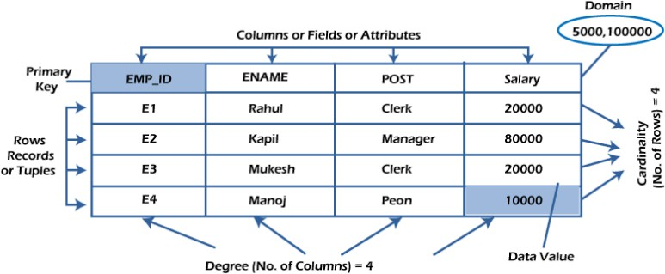
Terminologies of RDBMS

Slide 6


Everything in a relational database is stored in the form of relations.
The RDBMS database uses tables to
store data.
A table is a collection of related data entries and contains rows and columns to store data.
Each table represents some real-world objects such as person, place, or event about which information is collected.
The organized collection of data into a relational table is known as the logical view of the database.
What is table/ Relation?

Slide 7
Each relation has a unique name by which it is identified in the database.
Relation does not contain duplicate
tuples.
The tuples of a relation have no specific order.
All attributes in a relation are atomic, i.e., each cell of a relation contains exactly one value.
Properties of a Relation

Slide 8
Example: Student Table
ID | NAME | AGE | COURSE
1 | Ayyaz | 24 | B. Tech
2 | Kamil | 20 | CA
3 | Saqib | 21 | BCA
4 | Kamran | 22 | MCA
5 | Saeed | 26 | BSC

Slide 9



or tuple.
A row of a table is also called a record
What is a row or record?
It contains the specific information of each entry in the table.
It is a horizontal entity in the table.
For example, The above table contains 5 records.

Slide 10
All tuples of the relation have the same format and the same number of entries.
No two tuples are identical to each other in all their entries.
Properties of a Row
The order of the tuple is irrelevant. They are identified by their content, not by their position.

Slide 11
One record/ row in the table
ID | NAME | AGE | COURSE
1 | Ayyaz | 24 | B. Tech
ID | NAME | AGE | COURSE
1 | Ayyaz | 24 | B. Tech
2 | Kamil | 20 | CA
3 | Saqib | 21 | BCA
4 | Kamran | 22 | MCA
5 | Saeed | 26 | BSC

Slide 12
A column is a vertical entity in the table which contains all information associated with a specific field in a table.
For example, "name" is a column in the above table which contains all information about a student's name.
What is a column/ attribute?

Slide 13
Null values are permitted for the attributes.
Every attribute of a relation must have a name.
Properties of an Attribute
Default values can be specified for an attribute automatically inserted if no other value is specified for an attribute.
Attributes that uniquely identify each tuple of a relation are the primary key.

Slide 14
Attribute/ Column in the table
ID | NAME | AGE | COURSE
1 | Ayyaz | 24 | B. Tech
2 | Kamil | 20 | CA
3 | Saqib | 21 | BCA
4 | Kamran | 22 | MCA
5 | Saeed | 26 | BSC
 | NAME
 | Ayyaz
 | Kamil
 | Saqib
 | Kamran
 | Saeed

Slide 15
The smallest unit of data in the table is
the individual data item.
It is stored at the intersection of tuples and attributes.
What is data item/ cell?

Slide 16
Properties of Data Items
Data items are atomic.
The data items for an attribute should be drawn from the same domain.
In the below example, the data item in the
student table consists of Ajeet, 24 and Btech, etc
ID | NAME | AGE | COURSE
1 | Ayyaz | 24 | B. Tech

Slide 17
The total number of attributes that comprise a relation is known as the degree of the table.
ID | NAME | AGE | COURSE
1 | Ayyaz | 24 | B. Tech
2 | Kamil | 20 | CA
3 | Saqib | 21 | BCA
4 | Kamran | 22 | MCA
5 | Saeed | 26 | BSC
Degree
The student table has 4 attributes, and its
degree is 4.

Slide 18
The total number of tuples at any one time in a relation is known as the table's cardinality.
The relation whose cardinality is 0 is called an empty table.
ID | NAME | AGE | COURSE
1 | Ayyaz | 24 | B. Tech
2 | Kamil | 20 | CA
3 | Saqib | 21 | BCA
4 | Kamran | 22 | MCA
5 | Saeed | 26 | BSC
Cardinality
The student table has 5 rows, and its cardinality is 5.

Slide 19
The domain refers to the possible values each attribute can contain.
It can be specified using standard data types such as integers, floating numbers, etc.
For example,
An attribute entitled Marital_Status may be limited to married or unmarried values.
Domain

Slide 20
The NULL value of the table specifies that the field has been left blank during record creation.
It is different from the value filled with zero or a field that contains space.
NULL Values

Slide 21
Following are the categories of data integrity exist with each RDBMS:
Entity integrity:
It specifies that there should be no duplicate rows in a table.
Domain integrity:
It enforces valid entries for a given column by
restricting the type, the format, or the range of values.
Data Integrity
Referential integrity:
Specifies that rows cannot be deleted, which are used
by other records.
User-defined integrity:
It enforces some specific business rules defined by users. These rules are different from the entity, domain, or referential integrity.

Slide 22
Although DBMS and RDBMS both are used to store information in physical database but there are some remarkable differences between them.
The main differences between DBMS and RDBMS are given below:
Difference between DBMS and RDBMS

Slide 23
DBMS | RDBMS
DBMS applications store data as file. | RDBMS applications store data in a tabular form.
In DBMS, data is generally stored in either a hierarchical form or a navigational form. | In RDBMS, the tables have an identifier called primary key and the data values are stored in the form of tables.
Normalization is not present in DBMS. | Normalization is present in RDBMS.
DBMS does not apply any security with regards to data manipulation. | RDBMS defines the integrity constraint for the purpose of ACID (Atomicity, Consistency, Isolation and Durability) property.
DBMS uses file system to store data, so there will be no relation between the tables. | in RDBMS, data values are stored in the form of tables, so a relationship between these data values will be stored in the form of a table as well.
DBMS has to provide some uniform methods to access the stored information. | RDBMS system supports a tabular structure of the data and a relationship between them to access the stored information.
DBMS does not support distributed database. | RDBMS supports distributed database.
DBMS is meant to be for small organization and deal with small data. it supports single user. | RDBMS is designed to handle large amount of data. it supports multiple users.
Examples of DBMS are file systems, xml etc. | Example of RDBMS are mysql, postgre, sql server, oracle etc.

